Slide 1

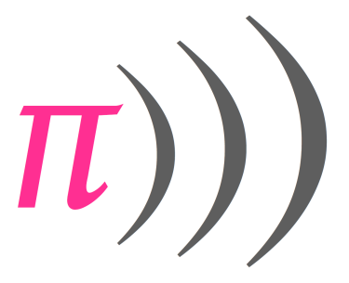
A Sonic Pi Workshop
For Kids
by Stefan Höhn, Irene Höppner und Matthias Malstädt
Buffer 0
Use Buffer 0 in Sonic Pi

Slide 2
play 60
sleep 1
Play and wait
80 60 62 64 65 20
67 69 71 72
:c4 :d4 :c5 :d5
play :c4
play :e4
play :g4
sleep 1
Play a chord (triad)
c5 e5 g5 f4 a4 c5 g4 a4 d5

Slide 3
BUFFER 1
Use Buffer 1

Slide 4
play_chord [:c4, :e4, :g4]
sleep 1
Multiple tones at the same time a re challed chords. This way is easier than before. It‘s a C-chord.
c5 e5 g5 f4 a4 c5 g4 a4 d5
play_chord chord(:e4, :major)
sleep 1
Major , Minor – Do you notice the difference?
:a4 :b4 :major7 :minor
3 Chords with a second distance (use e, a and b minor)

Slide 5
BUFFER 2
Use Buffer 2

Slide 6
play_pattern (scale :c4, :major)
Play a a pattern (multiple tones in a sequence) – here we a play a scale
:major :major_pentatonic :minor_pentatonic :minor
use_bpm 120
play_pattern (scale :e4, :minor)
Use a different speed. b p m = beats per minute
50 240 400 100 600
:major :major_pentatonic :minor_pentatonic :minor

Slide 7
use_bpm 600
2.times do
play_pattern (scale :e4, :minor)
end
2mal
2 times. We call this a loop.
3.times 5.times
live_loop :tonleiter do
use_bpm 120
play_pattern (scale :e4, :minor)
end
We call this an endless/infinite loop
Change to 480. Press Run and listen to when it changes. Immediately?

Slide 8
use_synth :saw
How about a different sound for our synthesizer?
:dsaw :mod_dsaw :prophet :piano
:blade :tb303 :pluck :dtri
play_pattern (scale :e4, :minor)
play_pattern (scale :e4, :minor).reverse
And now we play the scale backwards

Slide 9
BUFFER 3
live_loop :geblubber do
use_bpm 240
play_pattern (scale :e4, :minor).choose
sleep 1
end
Choose selects one tone randomly out of a set of tones. One a time only.
play only plays one note (compare to play_pattern that plays many)
choose selects a random one out of a set of notes

Slide 10
BUFFER 4
Use Buffer 4

Slide 11
live_loop :schlagzeug do
sample :bd_haus
sleep 1
end
An endless loop that can be changed during playing
Add another sample sn_zome with sleep 1
Make the drums faster (120)
:drum_bass_hard :drum_snare_hard :drum_tom_hi_hard

Slide 12
BUFFER 5
Use Buffer 5

Slide 13
live_loop :melodie do
sample :guit_em9
sleep 2
end
An electric guitar sample
Tryout and then copy the drums (buffer 4) and the melody together in to buffer 5
Now put everything together in buffer 6
First Buffer 5, then buffer 3 and then 2
Run again after each copying and listen
The copy buffer 1 and add a live_loop.
Something isn‘t quite right yet. What is it?
Use Size- and Size +. To change the size of the text
use_bpm use_synth :hollow ,amp: 5
use_synth: hoover

Slide 14
More ideas
Work on the drums
Play around with melodies
Effects
What about variables and conditions?
Samples „loop_“ with sample_duration()
Experiment with your mentor
a = 30
if a < 100
a = a +1
play a
else
a = 30
end
Variables and conditions
Add around a live_loop and listen. What happens here?

Slide 15
live_loop :withReverv do
with_fx :reverb, room: 0.9 do
play_pattern (scale :e4, :minor)
end
end
That‘s how you can apply effects
fx stands for „effects“. Each effect has its parameters: here the size of the room of the reverb.
Try other effects (see fx in help section)
Use play and choose and a speed of 300

Slide 16
Cheat sheet
play 60
sleep 1
use_bpm 600
play :c4
play_chord [:c4, :e4, :g4]
play_chord chord(:e4, :major) :major :major_pentatonic :minor_pentatonic :minor
play_pattern (scale :e4, :minor)
play_pattern (scale :e4, :minor).reverse
play (scale :e4, :minor).choose
use_synth :hollow → :saw, :hoover, :piano …
2.times do
...
end
live_loop :meineEndlosschleife do
...
end
sample :bd_haus → :guit_em9 ...

Slide 17



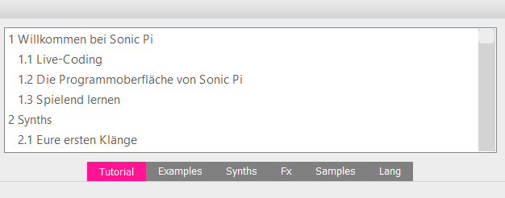
Cheat sheet
Keyboard shortcuts
ALT-R Run ALT-A Mark all
ALT-S Stop ALT-C Copy
ALT-V Insert
STRG-I Help for the current command
Buttons
Start Song Stopp Record
Save song Load song
Decrease Text Increase Format text in a nicer way
Manual for at home
Cool examples
Effects
All commands

Slide 18

Cheat sheet
use_synth
:beep :blade :bnoise :cnoise :dark_ambience
:dpulse :dsaw :dull_bell :fm :gnoise :growl
:hollow :hoover
:mod_beep :mod_dsaw :mod_fm :chiplead :chipbass :chipnoise
:mod_pulse :mod_saw :mod_sine :mod_tri :pule
:noise :piano :pnoise :pretty_bell :prophet :dtri :pluck
:saw :sine :square :subpulse :tb303 :tri :zawa
samples
:elec_triangle
:elec_snare
:elec_lo_snare
:elec_hi_snare
:elec_mid_snare
:elec_cymbal
:elec_soft_kick
:elec_filt_snare
:elec_fuzz_tom
:elec_chime
:elec_bong
:elec_twang
:elec_wood
:elec_pop
:elec_beep
:elec_blip
:elec_blip2
:elec_ping
:elec_bell
:elec_flip
:elec_tick
:elec_hollow_kick
:elec_twip
:elec_plip
:elec_blup
:bd_ada
:bd_pure
:bd_808
:bd_zum
:bd_gas
:bd_sone
:bd_haus
:bd_zome
:bd_boom
:bd_klub
:bd_fat
:bd_tek
:ambi_soft_buzz
:ambi_swoosh
:ambi_drone
:ambi_glass_hum
:ambi_glass_rub
:ambi_haunted_hum
:ambi_piano
:ambi_lunar_land
:ambi_dark_woosh
:ambi_choir
:bass_hit_c
:bass_hard_c
:bass_thick_c
:bass_drop_c
:bass_woodsy_c
:bass_voxy_c
:bass_voxy_hit_c
:bass_dnb_f
:drum_heavy_kick
:drum_tom_mid_soft
:drum_tom_mid_hard
:drum_tom_lo_soft
:drum_tom_lo_hard
:drum_tom_hi_soft
:drum_tom_hi_hard
:drum_splash_soft
:drum_splash_hard
:drum_snare_soft
:drum_snare_hard
:drum_cymbal_soft
:drum_cymbal_hard
:drum_cymbal_open
:drum_cymbal_closed
:drum_cymbal_pedal
:drum_bass_soft
:drum_bass_hard
:sn_dub
:sn_dolf
:sn_zome
:loop_industrial
:loop_compus
:loop_amen
:loop_amen_full
:loop_garzul
:loop_mika
:loop_breakbeat
:ambi_soft_buzz
:ambi_swoosh
:ambi_drone
:ambi_glass_hum
:ambi_glass_rub
:ambi_haunted_hum
:ambi_piano
:ambi_lunar_land
:ambi_dark_woosh
:ambi_choir
:drum_cowbell
:drum_roll
:misc_cros
:misc_cineboom
:perc_swash
:perc_till
:loop_safari
:loop_tabla
:misc_burp
:perc_bell
:perc_snap
:perc_snap2
:guit_harmonics
:guit_e_fifths
:guit_e_slide
:guit_em9

